Slide 1
Visualizing measles coverage data
CGT 370 FINAL PROJECT
Carol Hu, Kanak Dhawan, Yi Zhang

Slide 2
What’s our story?
Measles has played a critical role threatening people’s life but in the recent years it is being prevented by Measles vaccine.
Vaccination rate in some countries are significantly lower than that of average.
The visualization shows an overview of change of Measles immunization coverage worldwide over the years.

Slide 3
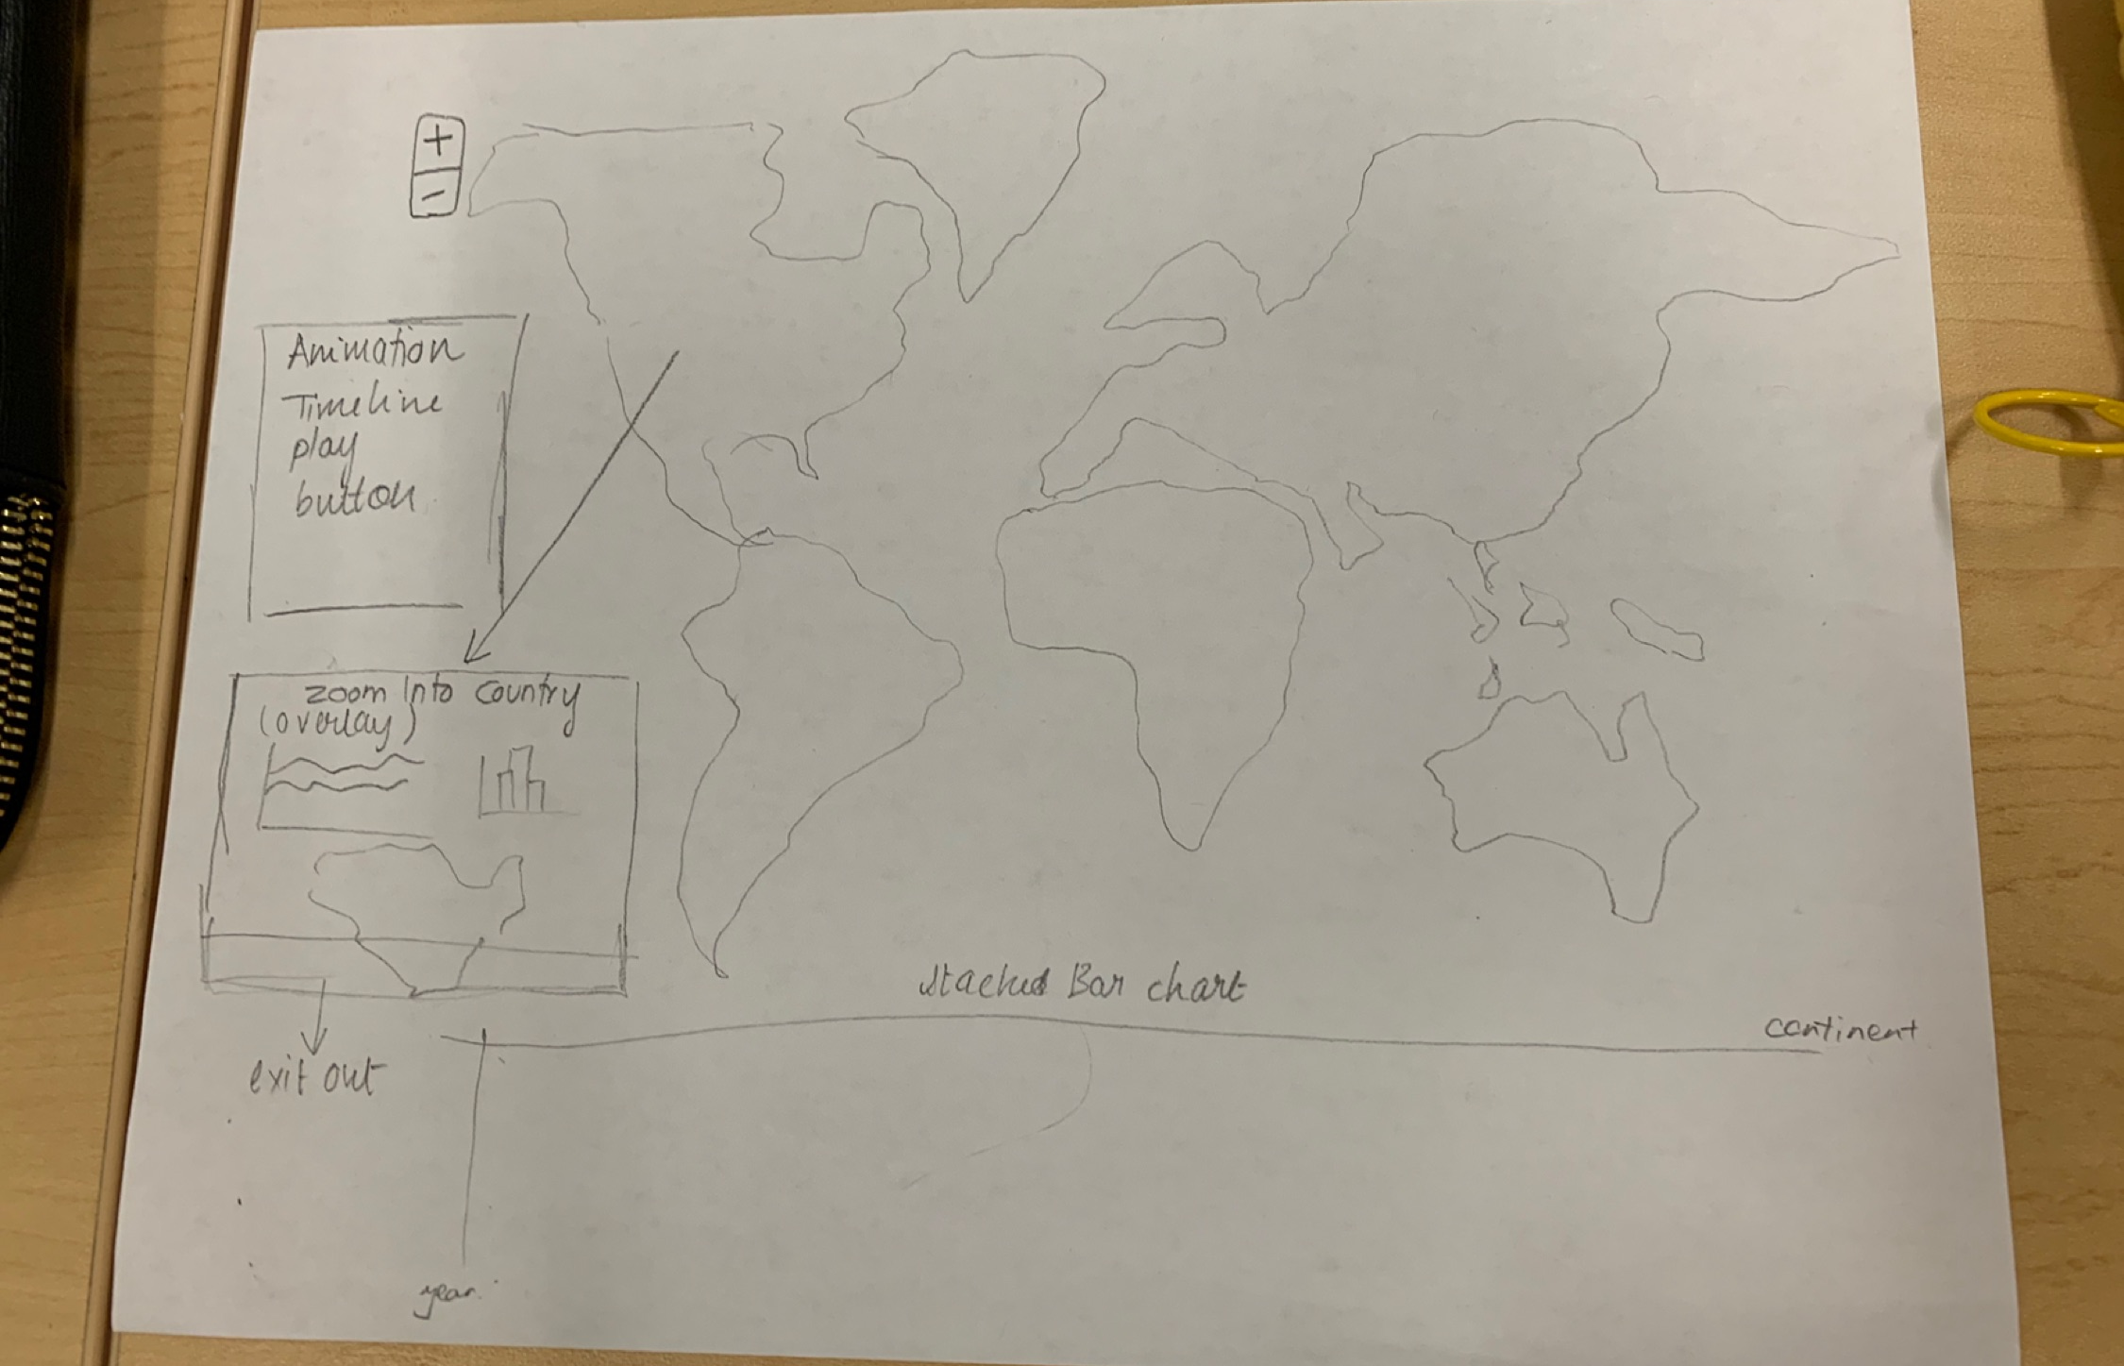


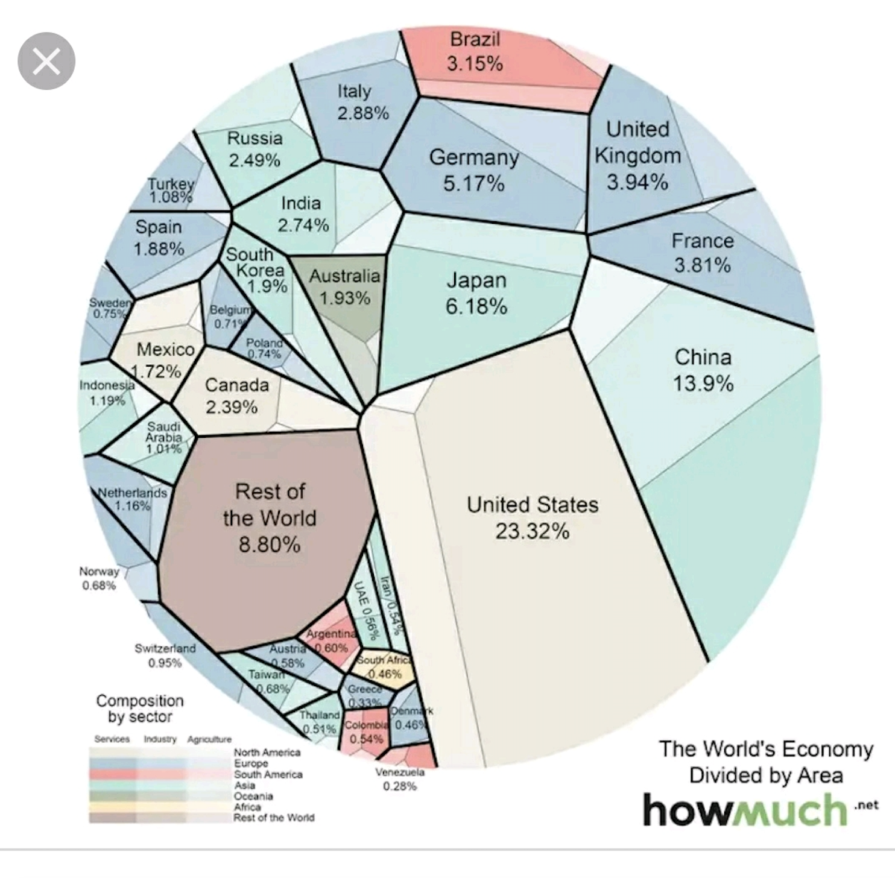
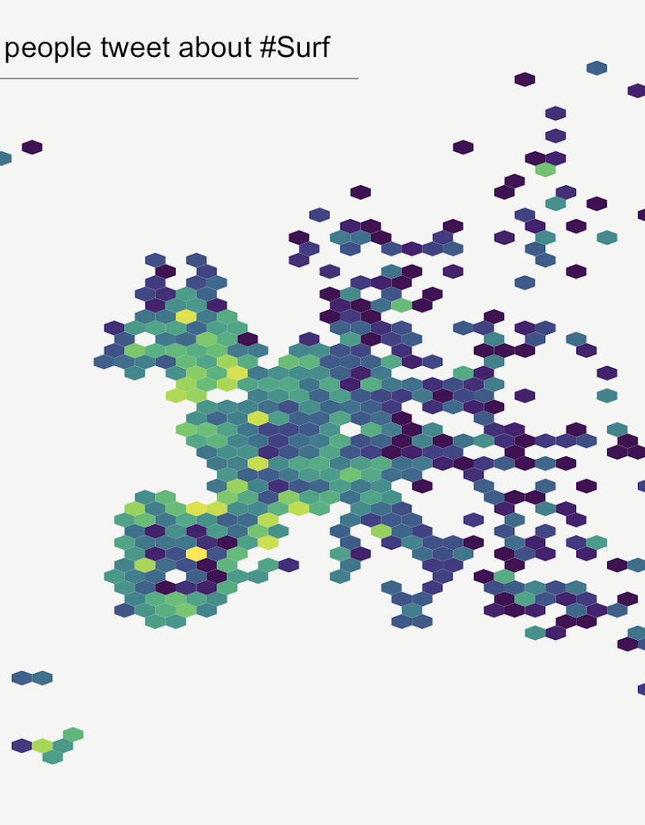
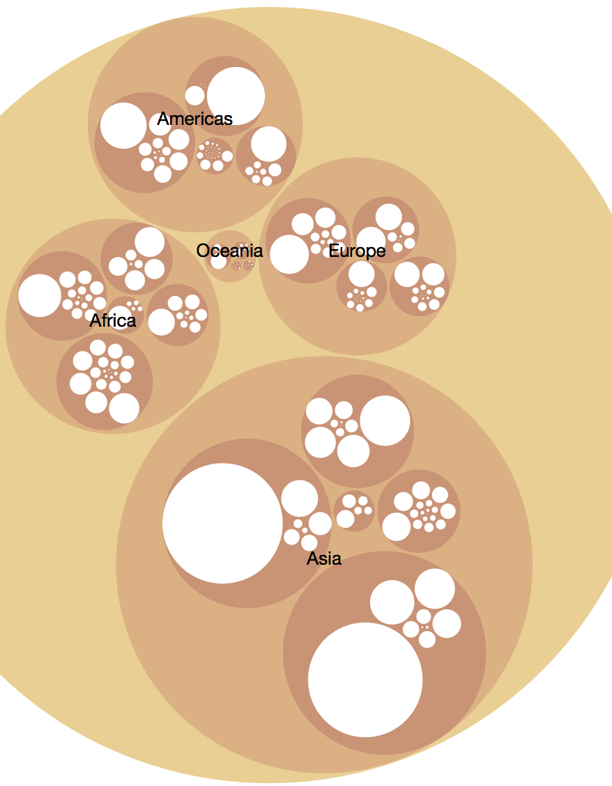
Ideation

Slide 4
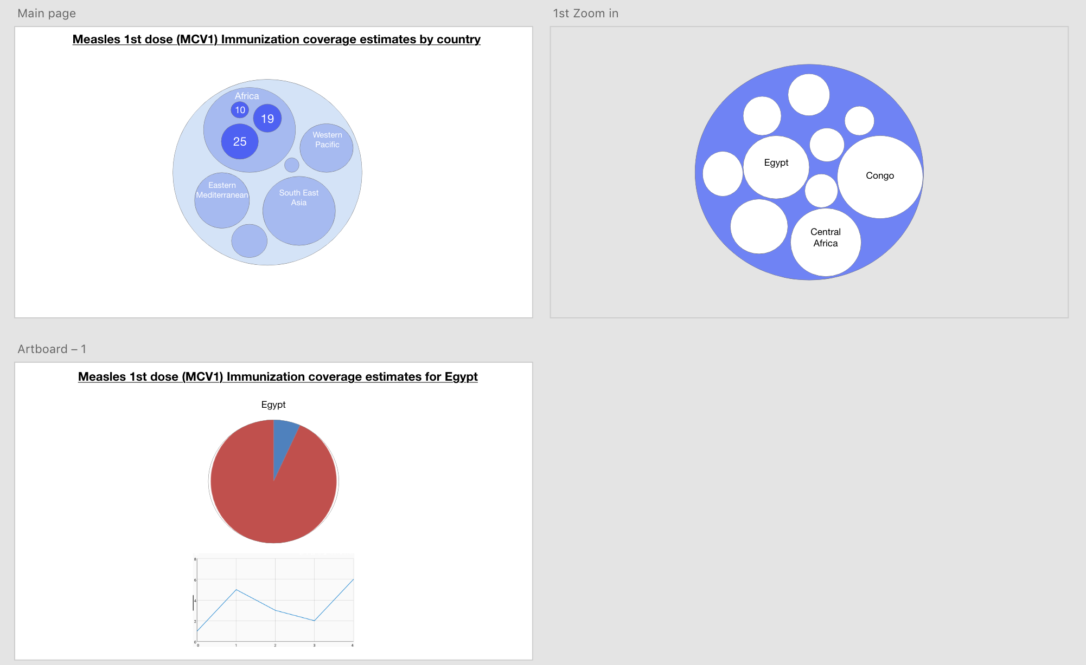
Prototype

Slide 5

tools

Slide 6
methodology
Data acquired from WHO (World Health Organization) in csv format
Acquire
Parsed manually and filtered using python
Parse and Filter
Visualization created using D3 and google chart
Represent and Interact

Slide 7
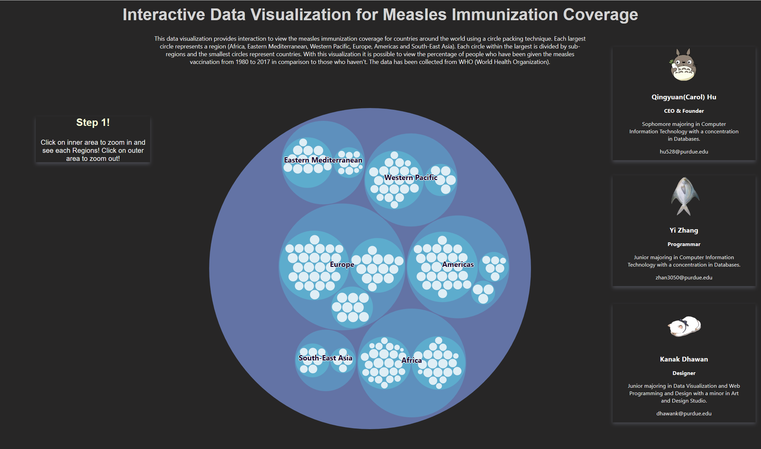
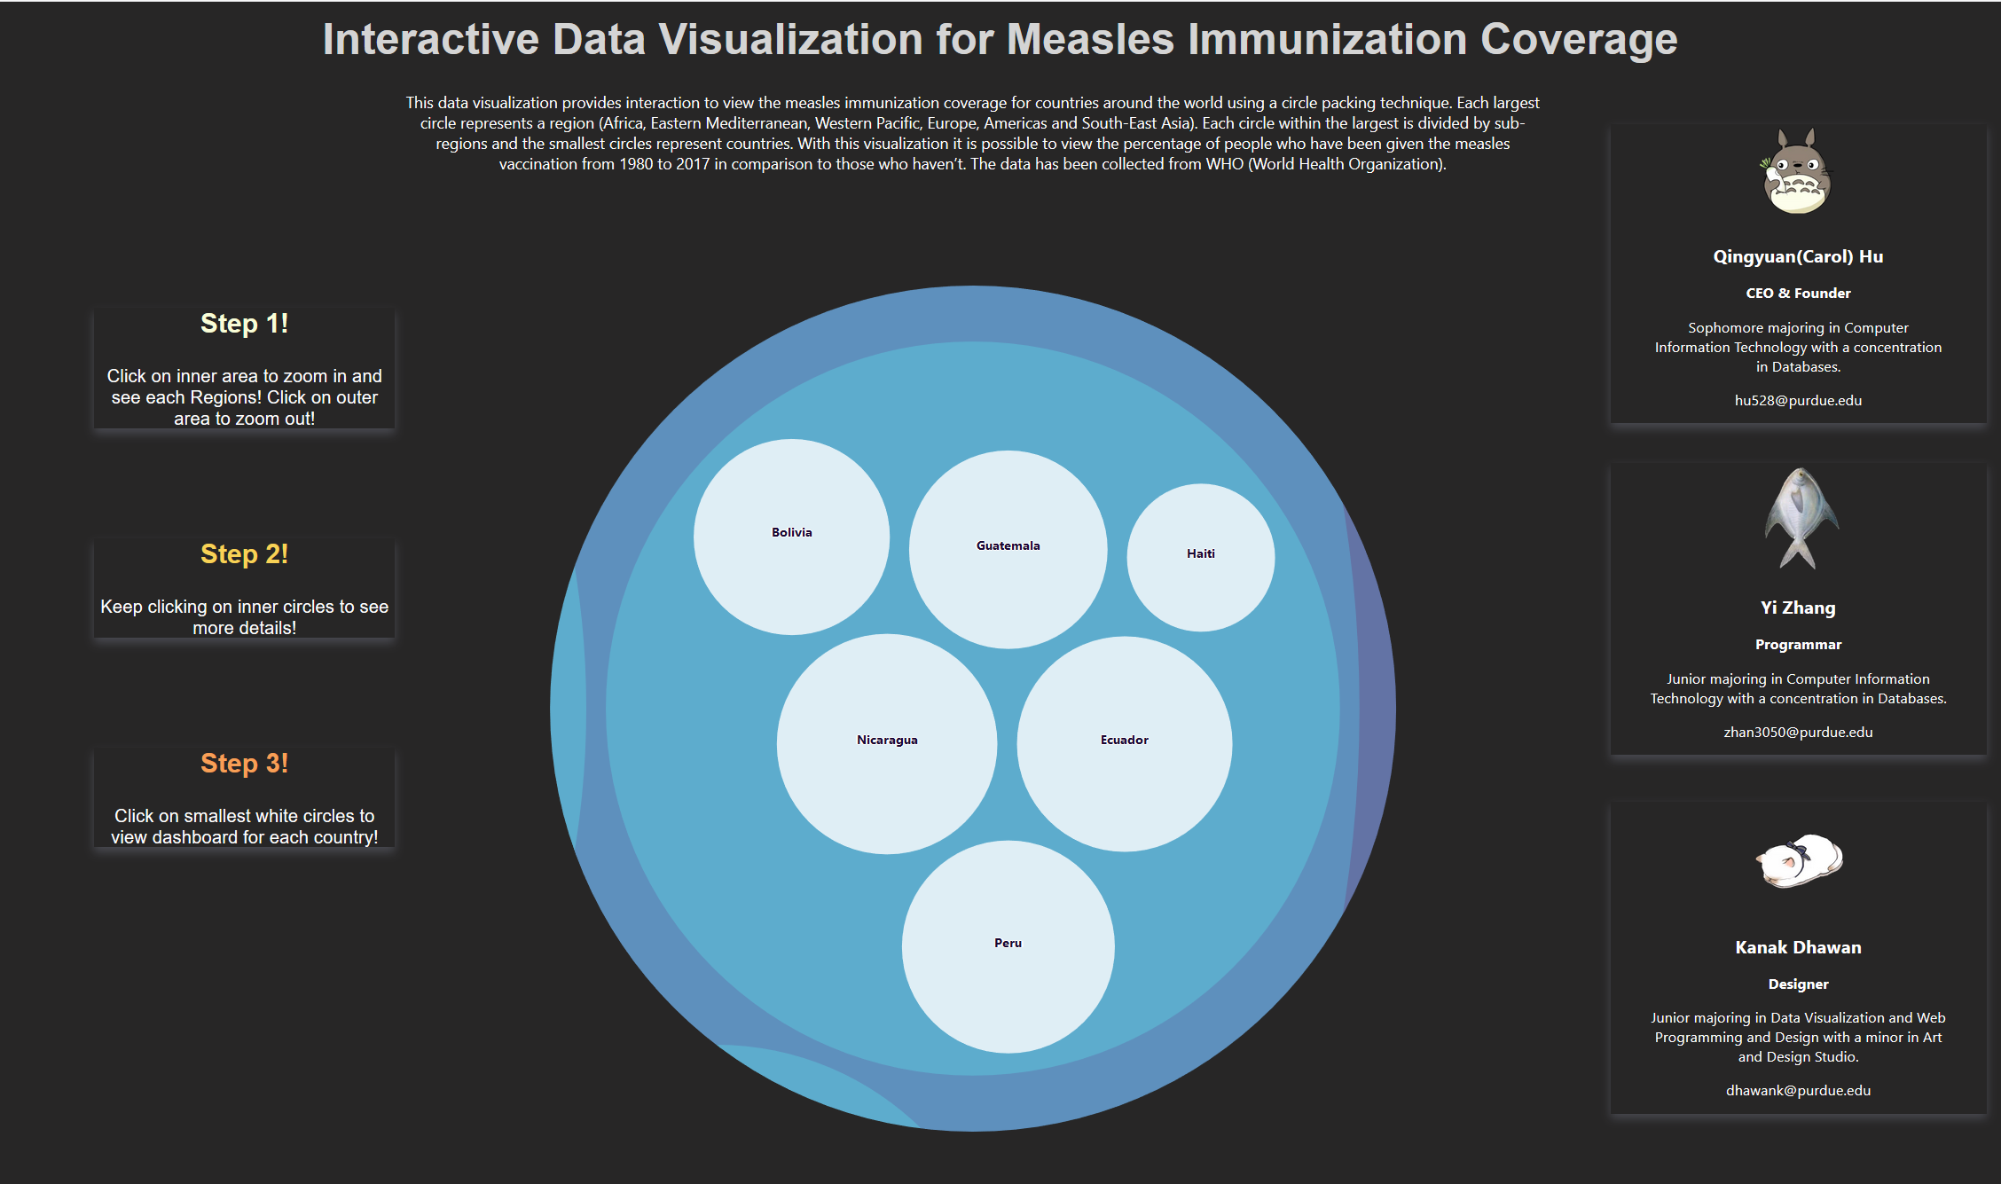
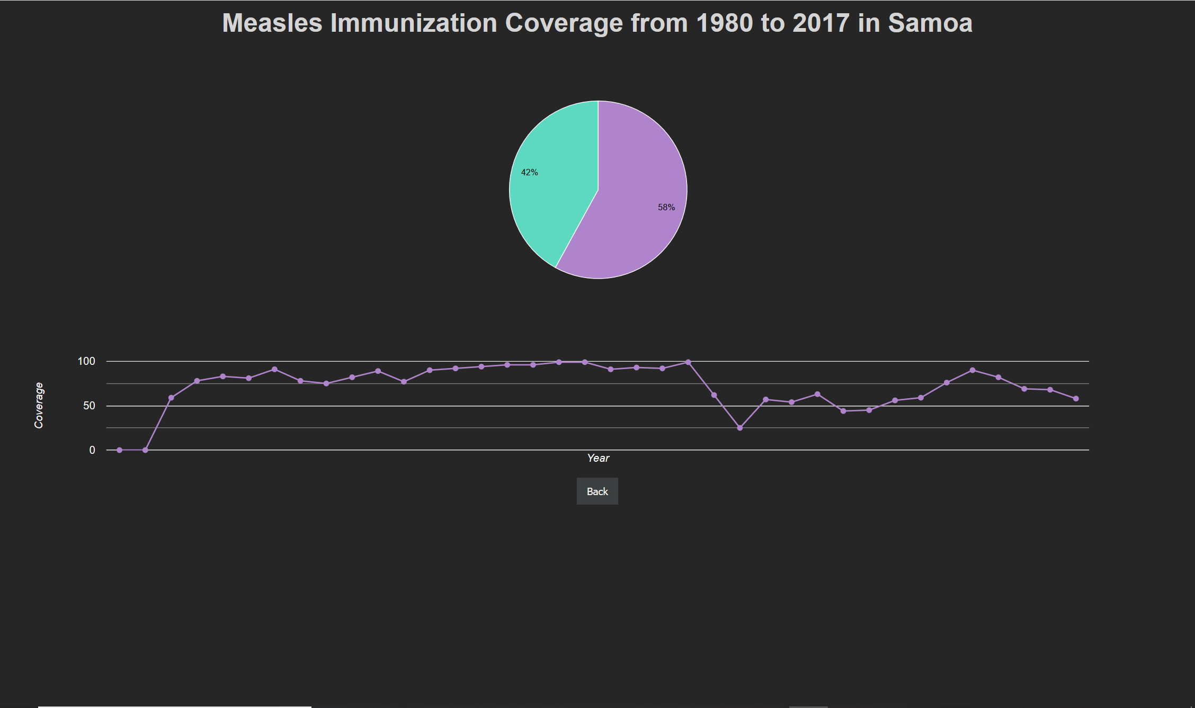
Interactive visualization

Slide 8
FUTURE WORK
Map
Map the circular packing map to a real world map
Highlight the corresponding country
Flag
Use country flag to color the circles
Layout
Adjust the layout according to the size of screen

Slide 9
Q & A
Thank you!

